Slide 1

Deploying Microsoft Azure Stack Hub
Installing Azure Stack Development Kit
This work is licensed under a Creative Commons Attribution - ShareAlike 4.0 International Public License

Slide 2
Agenda
Overview and architecture
Who, what, where, when, and why
Azure Stack Development Kit architecture
What it is, what it isn't
Deployment
Deployment tasks
References
Exploring with first tasks

Slide 3
Azure Stack Hub Development Kit Overview: Who, what, where, when, and why

Slide 4
Who should be interested?
Azure Stack Development Kit is targeted for the following:
An Azure-consistent cloud experience
Demonstrating Azure Stack Hub and services/applications on Azure Stack Hub
Evaluate Azure/Azure Stack Hub production (dev/test)
Developing hybrid and/or modern applications
Building the operational knowledge required to operate Azure Stack Hub
NOT for Production

Slide 5
What is the development kit?
The idea behind the Azure Stack Development Kit is:
Azure Consistent Hybrid cloud experience
Limited deployment duration (hours)
Minimal hardware required (deploys on one server)
A single node deployment of Azure Stack Hub (free)
Reduced component install (non-HA)
Easy to install (PowerShell)
Can integrate into a larger environment
Updated versions in-sync with integrated system (please note the ASDK cannot be updated with the same process as an Integrated System – you need to redeploy the ASDK with every new version)

Slide 6
Where can Azure Stack Hub Dev Kit be deployed?
Any system that meets the minimum hardware requirements
Existing datacenter system or large workstation machines meeting the minimum requirements
Dev Kit is assumed to have network access to the Internet
Minimum requirements:
Ensure you have the minimum storage, network and memory
Validation can be performed using the pre-req checker
(More detail on exact specs is coming up in a few slides)
https://docs.microsoft.com/en-us/azure/azure-stack/azure-stack-deploy

Slide 7
Why is the Development Kit important?
Minimum scale
Similarity to final production deployment
Repeatability of development experience prior to or alongside Azure Stack Hub production deployments
Simplicity
Ease and speed of (re)deployment, management, operations, and the reuse of existing collateral
Flexibility, low cost, low overhead
Minimum requirements that can easily be procured and adopted
Multiple deployment options (from minimum requirements to large single host machines)

Slide 8
Why is the Development Kit important?
Hardware and software modernization
Organizations familiar with traditional storage and networking solutions need to learn how software defined networking and storage models will affect IT service delivery.
Workload composition
Customers will need to review current workload architectural models and determine how faster, standardized design, and deployment cycles will affect your application and data platforms.
Workload management
Azure Stack Hub will enable customers to adopt a technology lifecycle model that moves at the speed of public cloud releases.
Azure Stack Hub will enable/introduce new operational processes, service models, and oversight that can help your teams make the most of your deployment from the start.
Operations

Slide 9
When to use what?
Azure
Azure Resource Policy
Azure Stack Hub
Development Kit
Azure Stack Hub
OEM Integrated System
Development
Modeling
Scale Testing
Use for Azure Stack Hub application or solution development using Azure Services:
Apply Azure Policy (Azure Stack Hub Policy module) to configure an Azure subscription with the same versioning and service availability as Azure Stack Hub
Azure Policy limits the resource types and services available in a subscription
Use for education on Azure Stack Hub administration and application solution development/validation:
Allows administrators to experience the administrative constructs and tenant administration in Azure Stack Hub
Allows developers to test solutions against the Azure services, including their API versions and difference, which are shipping in Azure Stack Hub
Use to validate an application or solution developed for Azure Stack Hub at scale:
Allows administrators to experience the administrative constructs in Azure Stack Hub
Allows developers to test solutions against the Azure services, including their API versions and difference, which are shipping in Azure Stack Hub

Slide 10
Azure Stack Development Kit: Architecture overview

Slide 11
Development Kit hardware requirements
Component | Minimum | Recommended
Disk drives: Operating System | 1 OS disk with minimum of 200 GB available for system partition (SSD or HDD) | 1 OS disk with minimum of 200 GB available for system partition (SSD or HDD)
Disk drives: General Azure Stack Hub POC Data | 4 disks. Each disk provides a minimum of 240 GB of capacity (SSD or HDD). All available disks will be used | 4 disks. Each disk provides a minimum of 400 GB of capacity (SSD or HDD). All available disks will be used*
Compute: CPU | Dual-Socket: 16 Physical Cores (total) | Dual-Socket: 20 Physical Cores (total)
Compute: Memory | 192 GB RAM | 256 GB RAM **
Compute: BIOS | Hyper-V Enabled (with SLAT support) | Hyper-V Enabled (with SLAT support)
Network: NIC | Windows Server 2012 R2 Certification required for NIC; no specialized features required | Windows Server 2012 R2 Certification required for NIC; no specialized features required
HW logo certification | Certified for Windows Server 2012 R2 | Certified for Windows Server 2016
* You will need more than this recommended capacity if you plan on adding many of the marketplace items from Azure
** Minimum memory to support PaaS resource providers
https://docs.microsoft.com/en-us/azure/azure-stack/azure-stack-deploy

Slide 12
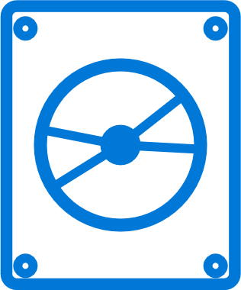
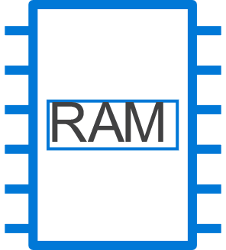
Development Kit hardware considerations
Ensure you have the minimum number of disks with consistent bus type and sizes
Ensure you have ample available disk space
A simple space (no resiliency) is created when you have less than 8 data disks and under 2 TB total space available
Ensure you have sufficient memory beyond the minimum to support workloads
Minimum memory (192 GB) will not adequately support the deployment additional resource providers such as SQL Server, MySQL Server, and Web Apps
RAM
Only IPv4 addresses are supported at this time
Azure Stack Hub VPN connections to Azure are not supported through NAT

Slide 13
Development Kit network considerations
Single connection required
Requires Internet access directly or through a transparent proxy
Reserved network ranges
192.168.200.0/24 – Infrastructure
192.168.100.0/27 – Storage
192.168.101.0/26 – HNV (PA)
192.168.102.0/24 – External VIP
192.168.103.0/25 – Transit Network
192.168.105.0/25 – Resource endpoints
Static or DHCP
Using a static IP requires additional deployment parameters
Only IPv4 is supported
Key differences
BGPNAT virtual machine is deployed (does not exist in multi-node)
No switch requirements - all traffic goes through a combination of the host NIC and specific VMs
Microsoft Confidential

Slide 14
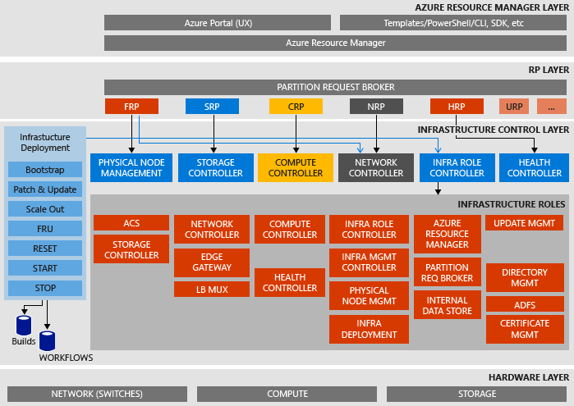
Development Kit and multi-node differences
Scale
One node where all infrastructure and tenant VMs coexist
Resiliency
While mirrored storage configurations are supported, it most likely will be configured as a Simple Space depending on hardware
Network
BGPNAT Virtual Machine is deployed (does not exist in multi-node)
No switch requirements – all traffic goes through a combination of the host NIC and specific VMs
Visibility
In the ASDK, you have administrative access to ‘see’ the fabric VMs that are normally hidden
https://docs.microsoft.com/en-us/azure/azure-stack/azure-stack-architecture

Slide 15
Using Azure Stack Development Kit wisely
The Development Kit is…
The Development Kit is not…
Use the Azure Stack Development Kit as:
A non-production deployment of Azure Stack Hub
A great place to start when exploring hybrid and/or modern application development
A single host that you can put together and deploy on your own
Your first impression of Azure Stack Hub (and possibly Azure) Services
Platform for validation of backup taken from integrated system
Risky scenarios for the Azure Stack Development Kit include:
Production hosting of Azure Stack Hub workloads
Assuming scalability beyond stated boundaries
Assuming it is a highly available solution
Deploying outside the defined configuration scripts (do not modify the scripts to fit an unsupported configuration)

Slide 16
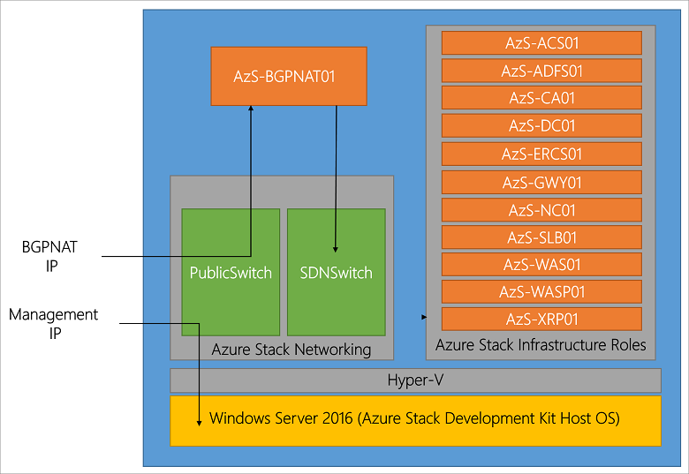
Azure Stack Development Kit Components
Name | Description
AzS-ACS01 | Azure Stack Hub storage services.
AzS-ADFS01 | Active Directory Federation Services (ADFS).
AzS-BGPNAT01 | Edge router and provides NAT and VPN capabilities for Azure Stack Hub.
AzS-CA01 | CA services for Azure Stack Hub role services.
AzS-DC01 | ADDS, DNS, and DHCP services for Azure Stack Hub.
AzS-ERCS01 | Emergency Recovery Console VM.
AzS-GWY01 | Edge gateway services such as VPN site-to-site connections for tenant networks.
AzS-NC01 | Network Controller, which manages Azure Stack Hub network services.
AzS-SLB01 | Load balancing multiplexer services in Azure Stack Hub for both tenants and Azure Stack Hub infrastructure services.
AzS-SQL01 | Internal data store for Azure Stack Hub infrastructure roles.
AzS-WAS01 | Azure Stack Hub administrative portal and Azure Resource Manager services.
AzS-WASP01 | Azure Stack Hub user (tenant) portal and Azure Resource Manager services.
AzS-XRP01 | Infrastructure management controller for Azure Stack Hub, including the Compute, Network, and Storage resource providers.
AzS-SRNG01 | Support Ring VM hosting the log collection service for Azure Stack.
https://docs.microsoft.com/en-us/azure/azure-stack/azure-stack-architecture

Slide 17
Azure Stack Development Kit: Deployment tasks

Slide 18
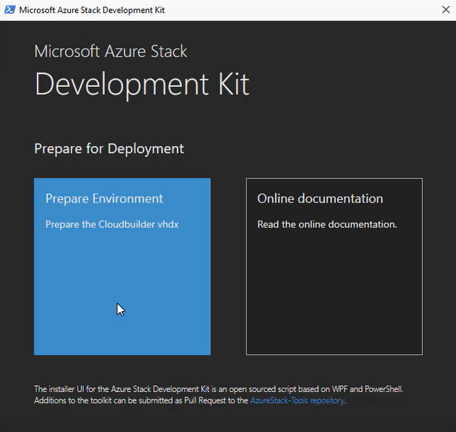
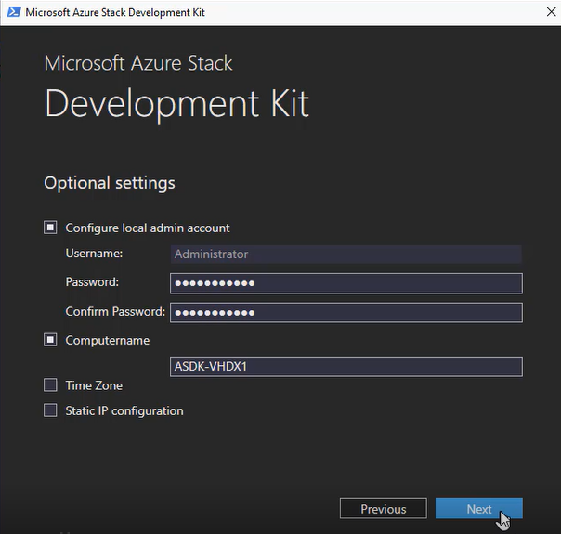
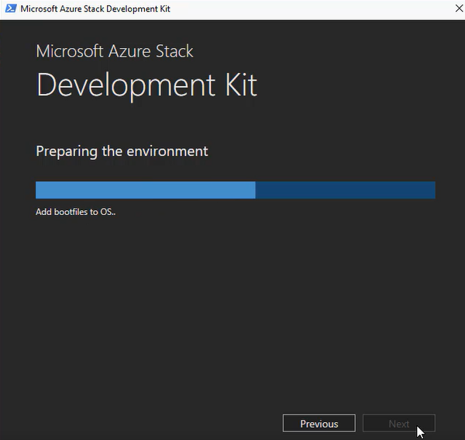
Azure Stack Hub Dev Kit: Deployment tool
Automated installation GUI - asdk-installer.ps1
https://github.com/Azure/AzureStack-Tools/tree/master/Deployment

Slide 19
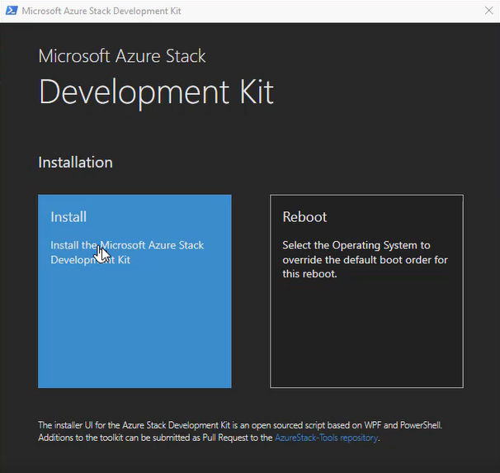
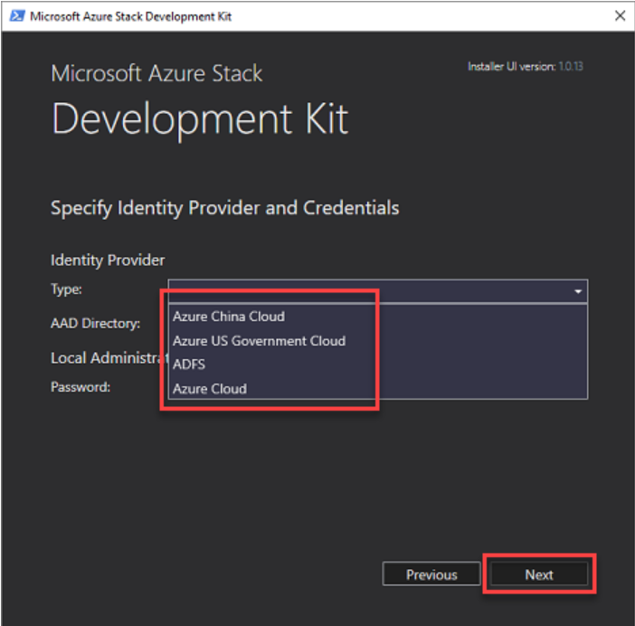
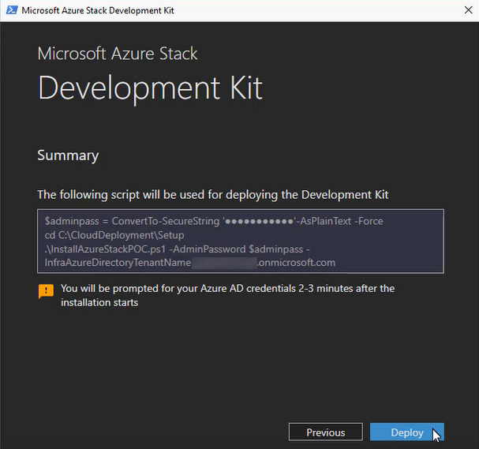
Azure Stack Hub Dev Kit: Deployment tool
Automated installation GUI - asdk-installer.ps1
https://github.com/Azure/AzureStack-Tools/tree/master/Deployment

Slide 20
Azure Stack Development Kit Deployment tasks and tooling

Slide 21
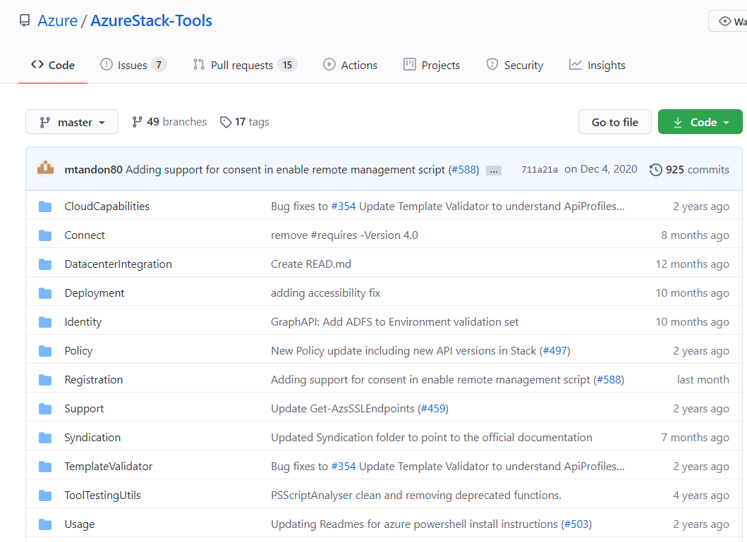
Azure Stack Hub tools GitHub repo
Scripts and tools that help customers use Azure and Azure Stack Hub
These tools can be used to complete or improve the following tasks:
Deployment and registration
Management and operations
First scenarios
Connect
Add default image
Create offers / plans / quotas
Environment testing
GitHub - Azure/AzureStack-Tools: Scripts and tools that help customers use Azure and Azure Stack

Slide 22
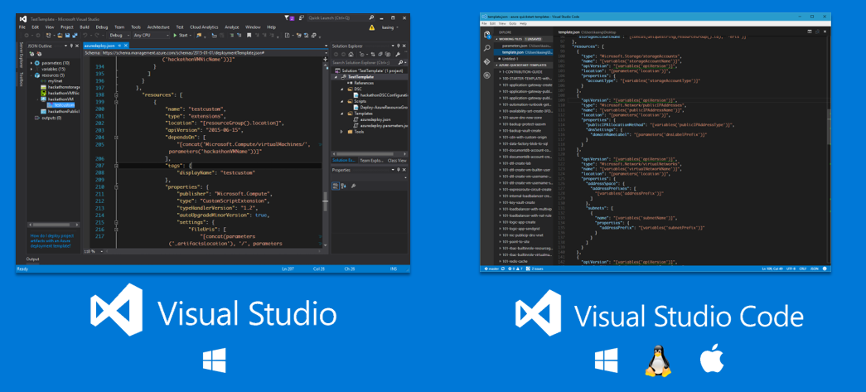
Enable your development environment

Slide 23
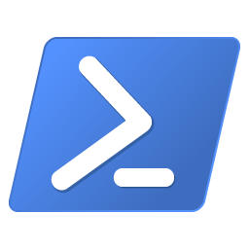
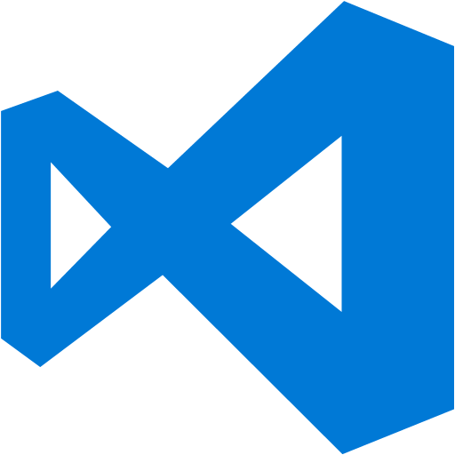
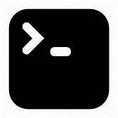
Administrative tools
Azure Stack Hub supports specific versions of Azure PowerShell
https://docs.microsoft.com/en-us/azure/azure-stack/azure-stack-powershell-install
Available on Windows, Ubuntu, CentOS, and Mac OS X
Visual Studio Code is available for Windows, Linux, and Mac OSX
Gotcha: When installing Visual Studio with PowerShell tools Azure PowerShell will be updated to an unsupported version
Azure Command Line Interface (CLI) provides multi-platform management support
Azure Stack Hub Command Line Interface tools installation

Slide 24
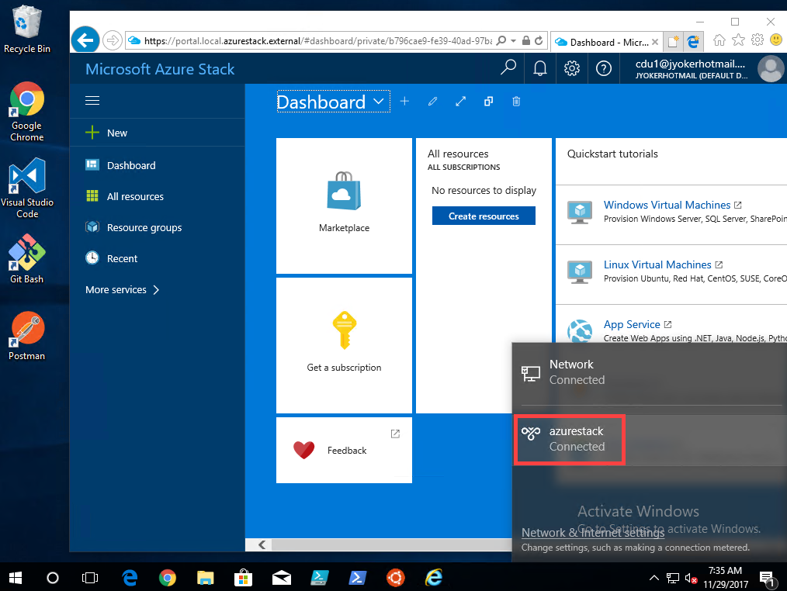
Connecting to Azure Stack Hub
Azure Stack Hub Tools PowerShell module
Allows for the creation of client VPN Connections
Remote clients supports a wider range of Azure tools (Storage explorer, etc)
Using a remote client vs. interactive login to the ASDK establishes a better analog to the integrated system through consistency in client access
Azure Stack Hub client connection tools - AzureStack.Connect.psm1
https://github.com/Azure/AzureStack-Tools/tree/master/Connect

Slide 25

Development Kit first scenarios
Add a default VM Image
Add a user to a role for a resource
Add/remove item from Marketplace
Create custom RBAC role in PowerShell
Deploy a gallery item from the Marketplace
Create an IaaS offer, plan
Browse a resource created in the portal
Sign up for a subscription to an offer
Sign up for an add-on plan to a subscription
Make an offer public
Publish or deploy a Gallery Item
Registration and syndication
Delete a resource from a portal
See Audit Logs from ARM in the portal
Download and deploy ARM templates using Azure xplat CLI from Mac, Windows, and Linux
Retrieve a tenant’s usage data through APIs
Give a tenant user a subscription
As a tenant retrieve my usage data through APIs
Use the documentation for Delegated Provider to setup/configure Delegated Provider scenarios
As an Admin, retrieve my tenant's usage
Deploy, operate, and scale modern virtualized cloud applications
Notes:
Azure-Stack-Hub-Foundation-Core/ASF-Training/ASF-workshop at master · Azure-Samples/Azure-Stack-Hub-Foundation-Core (github.com)

Slide 26
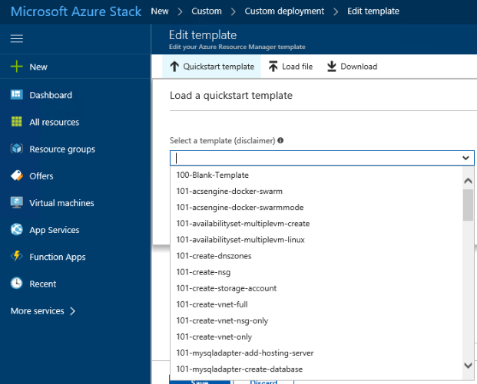
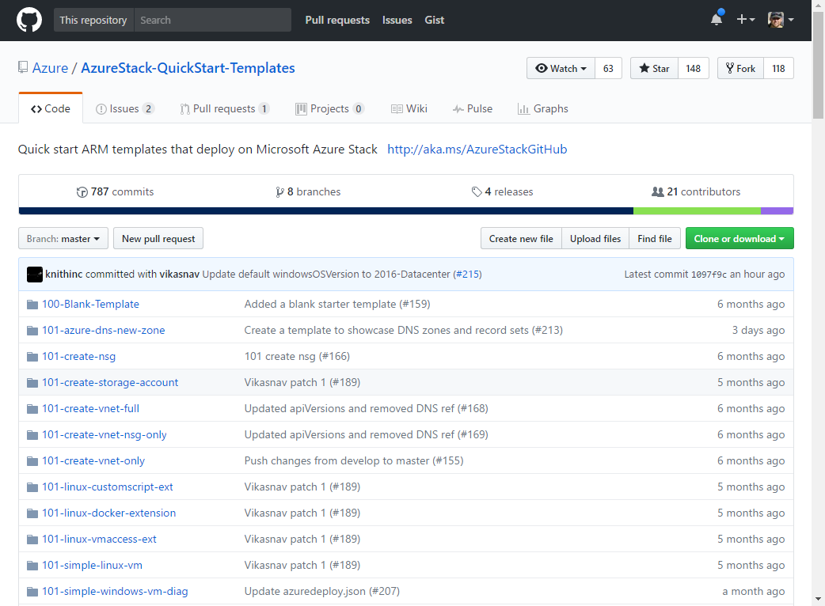
Getting started
Azure QuickStart templates
Community contributed ARM templates to accelerate learning and deployment of Azure Services
Contains a contribution guide and best practices
https://azure.microsoft.com/en-us/resources/templates/
Azure Stack Hub support
Contains deployment templates that have been tested on Microsoft Azure Stack Hub technical preview
https://github.com/Azure/AzureStack-QuickStart-Templates
Microsoft Confidential

Slide 27
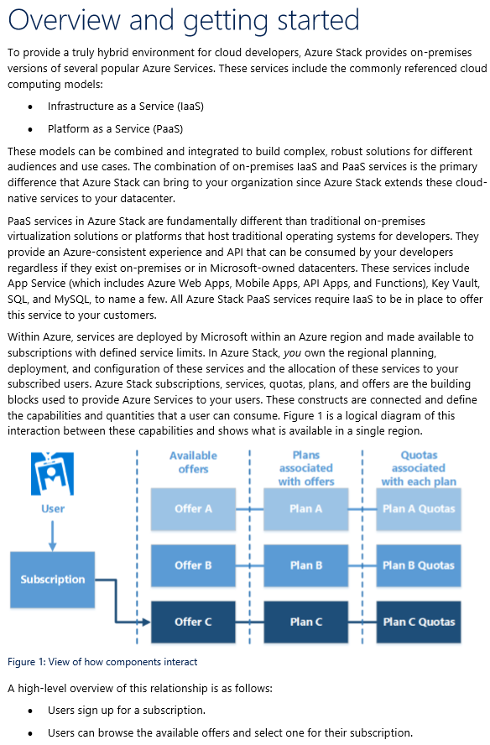
Getting started
Azure Stack Hub: Building an end-to-end validation environment eBook
Outlines things you need to do to configure Azure Stack Hub to offer services to your tenants
Steps to plan and deploy your Azure Stack Hub POC for your service or application
Guidance on how to build an end-to-end solution for validation of Azure Stack Hub
Includes:
Core concepts required to build a functional Azure Stack Hub environment, including
Constructs and configurable options available in Azure Stack Hub and key considerations that go into planning a successful implementation.
IaaS Series
https://azure.microsoft.com/blog/azure-stack-iaas-part-one/
Microsoft Confidential
Notes:
you want to check out Azure Stack: Building an end-to-end validation environment. But sometimes there are other blogs or posts that you can find other good nuggets of information. One such list of is the Azure Stack IaaS Series - https://azure.microsoft.com/blog/azure-stack-iaas-part-one/ and also check the Azure Stack Blog - Microsoft Tech Community

Slide 28
Account considerations
Account | Azure Active Directory (AAD) | Active Directory Federation Services (AD FS)
.\Administrator | ASDK host administrator | Same rights as AAD
AzureStack\AzureStackAdmin | Can be used to log in to Azure Stack Hub Admin Portal ASDK host administrator Access to view and administrate Service Fabric rings | Same rights as AAD
AzureStack\CloudAdmin | Can access and run permitted commands within the PrivilegedEndpoint | Owner of the Default Provider Subscription (DPS) Cannot login to the ASDK host Can access and run permitted commands within the PrivilegedEndpoint
Azure Active Directory Global Administrator installation account | Used during installation Owner of the Default Provider Subscription (DPS) | N/A
Azure Stack Hub administration basics - Azure Stack Hub | Microsoft Docs

Slide 29
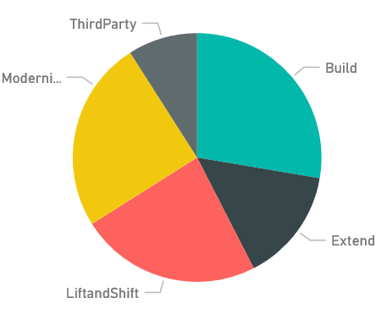
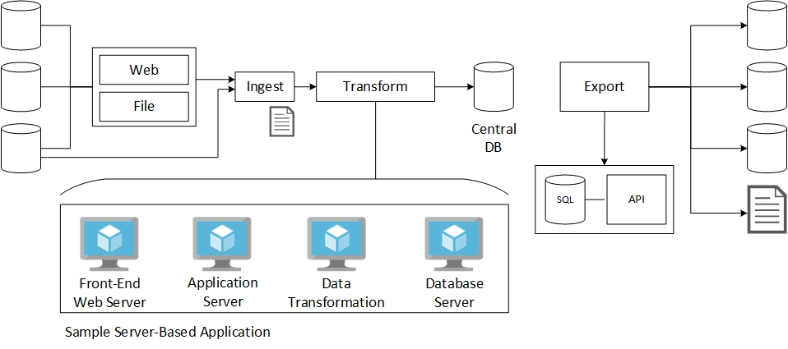
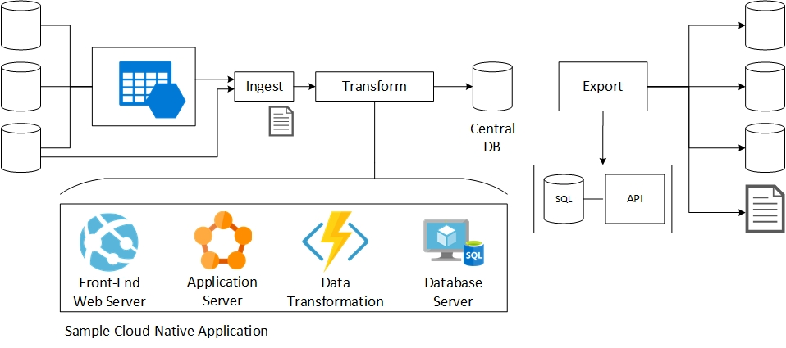
Start planning your workloads now
Re-envision existing applications
Start now to transition to new application models using native Azure Services

Slide 30
Azure Stack Development Kit Updates and add-ins

Slide 31

Development Kit lifecycle awareness
ASDK deployments do not have a patch and update process like production Azure Stack Hub deployments
Each new ASDK release requires a redeployment
Remove Registration resource
Must Re-register the ASDK
Perform a proper backup of development workloads
Use infrastructure-as-code artifacts
Redeploy Azure Stack Hub https://docs.microsoft.com/en-us/azure/azure-stack/azure-stack-redeploy
Notes:
If you've previously registered your ASDK installation with Azure, you should remove the registration resource before redeploying the ASDK. Re-register the ASDK to enable the availability of items in the marketplace when you redeploy the ASDK

Slide 32
ASDK lifecycle management
Domain Password Expiration
AAD Password Expiration
Resource Provider Updates
ASDK Platform Updates
Key concept: ASDK is a “living deployment” that requires active redeployment to maintain and keep up to date

Slide 33
Questions?

